Slide 1
COMP 2400
Week 5 - Friday

Slide 2
Last time
What did we talk about last time?
Finished arrays
Strings

Slide 3
Questions?

Slide 4
Review

Slide 5
What is Unix?
It's a standard for operating systems based on a long, complex history with many companies and innovators
The Open Group has the trademark on the term "UNIX," and you're only allowed to call your OS Unix if it meets their Single UNIX Specification
Linux and FreeBSD and other free implementations of Unix do not meet this specification

Slide 6

Linux
Linus Torvalds started working in 1991 to make a Unix kernel to run on an Intel 386
He put Linus's Unix (Linux) under the GNU GPL
The BSD distributions also gave rise to free BSD implementations (notably FreeBSD), but their usage is much less widespread than Linux
Linux kernel version numbers are x.y.z where x is a major version, y is a minor version, and z is a minor revision

Slide 7
Types in C
Basic types in C are similar to those in Java, but there are fewer
There's a bool in C99 but not in C90
Type | Meaning | Size
char | Smallest addressable chunk of memory | Usually 1 byte
short | Short signed integer type | At least 2 bytes
int | Signed integer type | At least 2 bytes, usually 4 bytes
long | Long signed integer type | At least 4 bytes
float | Single precision floating point type | Usually 4 bytes
double | Double precision floating point type | Usually 8 bytes

Slide 8
But, wait, it gets worse …
Unlike Java, C has signed and unsigned versions of all of its integer types
  Perhaps even worse, there's more than one way to specify their names
Type | Equivalent Types
char | signed char
unsigned char
short | signed short short int signed short int
unsigned short | unsigned short int
int | signed int
unsigned int | unsigned
long | signed long long int signed long int
unsigned long | unsigned long int

Slide 9
Hello, World
The standard Hello World program is simpler in C, since no external classes are needed
#include <stdio.h>
int main()
{
printf("Hello, World!\n");
return 0;
}

Slide 10
Sample makefile
Makefiles are called makefile or Makefile
all: hello
hello: hello.c
gcc -o hello hello.c
clean:
rm -f *.o hello

Slide 11
Bases
Know how to convert between all of the following:
  Base 2 (binary)
  Base 8 (octal)
  Base 10 (decimal)
  Base 16 (hexadecimal)

Slide 12
Integers in other bases
You can also write a literal in hexadecimal or octal
A hexadecimal literal begins with 0x
  int a = 0xDEADBEEF;
  Hexadecimal digits are 0 – 9 and A – F (upper or lower case)
An octal literal begins with 0
  int b = 0765;
  Octal digits are 0 – 7
  Be careful not to prepend other numbers with 0, because they will be in octal!
Remember, this changes only how you write the literal, not how it is stored in the computer
Can't write binary literals in standard C (even though gcc allows it)

Slide 13
Binary representation
Using a normal base 10 to base 2 conversion works fine for unsigned integer values
  However many bits you've got, take the pattern of 1's and 0's and convert to decimal
What about signed integers that are negative?
  Most modern hardware (and consequently C and Java) use two's complement representation

Slide 14
Negative integer in two's complement
Let's say you have a positive number n and want the representation of –n in two's complement with k bits
Figure out the pattern of k 0's and 1's for n
Flip every single bit in that pattern (changing all 0's to 1's and all 1's to 0's)
  This is called one's complement
Then, add 1 to the final representation as if it were positive, carrying the value if needed

Slide 15
Floating point representation
Okay, how do we represent floating point numbers?
A completely different system!
  IEEE-754 standard
  One bit is the sign bit
  Then some bits are for the exponent (8 bits for float, 11 bits for double)
  Then some bits are for the mantissa (23 bits for float, 52 bits for double)

Slide 16
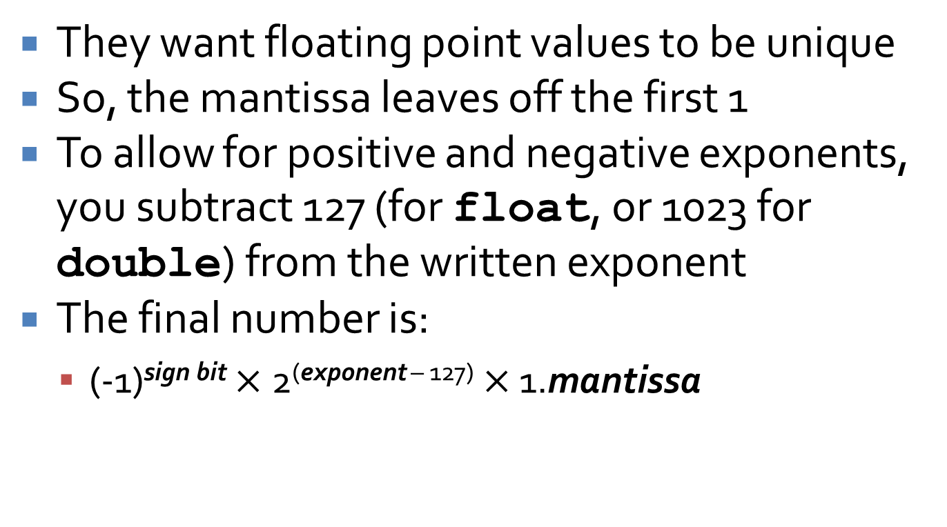
More complexity
They want floating point values to be unique
So, the mantissa leaves off the first 1
To allow for positive and negative exponents, you subtract 127 (for float, or 1023 for double) from the written exponent
The final number is:
  (-1)^{sign bit} $×$ 2^{(exponent – 127)} $×$ 1.mantissa

Slide 17
One little endian
For both integers and floating-point values, the most significant bit determines the sign
  But is that bit on the rightmost side or the leftmost side?
  What does left or right even mean inside a computer?
The property is the endianness of a computer
Some computers store the most significant bit first in the representation of a number
  These are called big-endian machines
Others store the least significant bit first
  These are called little-endian machines

Slide 18
Math library
Function | Result | Function | Result
cos(double theta) | Cosine of theta | exp(double x) | e^{x}
sin(double theta) | Sine of theta | log(double x) | Natural logarithm of x
tan(double theta) | Tangent of theta | log10(double x) | Common logarithm of x
acos(double x) | Arc cosine of x | pow(double base, double exponent) | Raise base to power exponent
asin(double x) | Arc sine of x | sqrt(double x) | Square root of x
atan(double x) | Arc tangent of x | ceil(double x) | Round up value of x
atan2(double y, double x) | Arc tangent of y/x | floor(double x) | Round down value of x
fabs(double x) | Absolute value of x | fmod(double value, double divisor) | Remainder of dividing value by divisor

Slide 19
Preprocessor directives
There are preprocessor directives which are technically not part of the C language
These are processed before the real C compiler becomes involved
The most important of these are
  #include
  #define
  Conditional compilation directives

Slide 20
sizeof
We said that the size of int is compiler dependent, right?
  How do you know what it is?
sizeof is a built-in operator that will tell you the size of a data type or variable in bytes
#include <stdio.h>
int main() {
printf("%d", sizeof(char));
int a = 10;
printf("%d", sizeof(a));
double array[100];
printf("%d", sizeof(array));
return 0;
}

Slide 21
const
In Java, constants are specified with the final modifier
In C, you can use the keyword const
Note that const is only a suggestion
  The compiler will give you a warning if you try to assign things to const values, but there are ways you can even get around that
Arrays have to have constant size in C
Since you can dodge const, it isn't strong enough to be used for array size
That's why #define is more prevalent
const double PI = 3.141592;

Slide 22
char values
C uses one byte for a char value
This means that we can represent the 128 ASCII characters without a problem
  In many situations, you can use the full 256 extended ASCII sequence
  In other cases, the (negative) characters will cause problems
Beware the ASCII table!
  Use it and die!

Slide 23
Bitwise operators
Now that we have a deep understanding of how the data is stored in the computer, there are operators we can use to manipulate those representations
These are:
  & Bitwise AND
  | Bitwise OR
  ~ Bitwise NOT
  ^ Bitwise XOR
  << Left shift
  >> Right shift

Slide 24
Precedence
Operators in every programming language have precedence
Some of them are evaluated before others
  Just like order of operations in math
* and / have higher precedence than + and –
  = has a very low precedence
I don't expect you to memorize them all, but
  Know where to look them up
  Don't write confusing code

Slide 25
Precedence table
Type | Operators | Associativity
Primary Expression | () [] . -> expr++ expr-- | Left to right
Unary | * & + - ! ~ ++expr --expr (typecast) sizeof | Right to left
Binary | * / % | Left to right
 | + -
 | >> <<
 | < > <= >=
 | == !=
 | &
 | ^
 | |
 | &&
 | ||
Ternary | ?: | Right to left
Assignment | = += -= *= /= %= >>= <<= &= ^= |= | Right to left
Comma | , | Left to right

Slide 26
if statements
Like Java, the body of an if statement will only execute if the condition is true
  The condition is evaluated to an int
  True means not zero
An else is used to mark code executed if the condition is false
Sometimes this is natural and clear; at other times it can be cryptic.

Slide 27
Nesting
We can nest if statements inside of other if statements, arbitrarily deep
Just like Java, there is no such thing as an else if statement
But, we can pretend there is because the entire if statement and the statement beneath it (and optionally a trailing else) is treated like a single statement

Slide 28
switch statements
switch statements allow us to choose between many listed possibilities
Execution will jump to the matching label or to default (if present) if none match
  Labels must be constant (either literal values or #define constants)
Execution will continue to fall through the labels until it reaches the end of the switch or hits a break
  Don't leave out break statements unless you really mean to!

Slide 29
Three loops
C has three loops, just like Java
  while loop
    You don't know how many times you want to run
  for loop
    You know how many times you want to run
  do-while loop
    You want to run at least once
Like if statements, the condition for them will be evaluated to an int, which is true as long as it is non-zero
  All loops execute as long as the condition is true

Slide 30
Bad things
Avoid the following constructs except when necessary:
  break
    Leaves loop immediately
    Necessary for switch statements
  continue
    Jumps to bottom of loop immediately
Avoid the following construct always:
  goto

Slide 31
Systems programming concepts
Kernel
  The part of the OS that does everything important
Process
  A currently running program
Shell
  The program you type commands into
Users and groups
  Users that can log in to the machines and logical groupings of them for permission purposes
Superuser
  The user that can do everything, often named root
Files
  All input and output in Unix/Linux is viewed as a file operation

Slide 32
Anatomy of a function definition
type name( arguments )
{
statements
}

Slide 33
Differences from Java methods
You don't have to specify a return type
  But you should
  int will be assumed if you don't
If you start calling a function before it has been defined, it will assume it has return type int and won't bother checking its parameters

Slide 34
Prototypes
Because the C language is older, its compiler processes source code in a simpler way
It does no reasonable typechecking if a function is called before it is defined
To have appropriate typechecking for functions, create a prototype for it
Prototypes are like declarations for functions
  They usually come in a block at the top of your source file

Slide 35
Return values
C does not force you to return a value in all cases
  The compiler may warn you, but it isn't an error
Your function can "fall off the end"
Sometimes it works, other times you get garbage
int sum(int a, int b)
{
int result = a + b;
return result;
}
int sum(int a, int b)
{
int result = a + b;
}

Slide 36
Useful Recursion
Two parts:
Base case(s)
  Tells recursion when to stop
  For factorial, n = 1 or n = 0 are examples of base cases
Recursive case(s)
  Allows recursion to progress
  "Leap of faith"
  For factorial, n > 1 is the recursive case

Slide 37
Code for Factorial
long long factorial( int n )
{
if( n <= 1 )
return 1;
else
return n*factorial( n – 1 );
}
Base Case
Recursive
Case

Slide 38
Scope
The scope of a name is the part of the program where that name is visible
In Java, scope could get complex
  Local variables, class variables, member variables,
  Inner classes
  Static vs. non-static
  Visibility issues with public, private, protected, and default
C is simpler
  Local variables
  Global variables

Slide 39
Hiding
If there are multiple variables with the same name, the one declared in the current block will be used
If there is no such variable declared in the current block, the compiler will look outward one block at a time until it finds it
Multiple variables can have the same name if they are declared at different scope levels
  When an inner variable is used instead of an outer variable with the same name, it hides or shadows the outer variable
Global variables are used only when nothing else matches
Minimize variable hiding to avoid confusion

Slide 40
Compiling multiple files
C files
  All the sources files that contain executable code
  Should end with .c
Header files
  Files containing extern declarations and function prototypes
  Should end with .h
Makefile
  File used by Unix make utility
  Should be named either makefile or Makefile

Slide 41
Declaration of an array
To declare an array of a specified type with a given name and a given size:
Example with a list of type int:
type name[ size ];
int list[ 100 ];

Slide 42
Differences from Java
When you declare an array, you are creating the whole array
There is no second instantiation step
  It is possible to create dynamic arrays using pointers and malloc(), but we haven't talked about it yet
You must give a fixed size (literal integer or a #define constant) for the array
These arrays sit on the stack in C
  Creating them is fast, but inflexible
  You have to guess the maximum amount of space you'll need ahead of time

Slide 43
Accessing elements of an array
You can access an element of an array by indexing into it, using square brackets and a number
Once you have indexed into an array, that variable behaves exactly like any other variable of that type
You can read values from it and store values into it
Indexing starts at 0 and stops at 1 less than the length
  Just like Java
list[9] = 142;
printf("%d", list[9]);

Slide 44
Length of an array
The length of the array must be known at compile time
There is no length member or length() method
It's unwise to use sizeof()

Slide 45
Passing arrays to functions
Using an array in a function where it wasn't created is a little different
You have to pass in the length
The function should list an array parameter with empty square brackets on the right of the variable
No brackets should be used on the argument when the function is called
Like Java, arguments are passed by value, but the contents of the array are passed by reference
  Changes made to an array in a function are seen by the caller

Slide 46
Memory
An array takes up the size of each element times the length of the array
Each array starts at some point in computer memory
The index used for the array is actually an offset from that starting point
That’s why the first element is at index 0

Slide 47
There are no strings in C
Unfortunately, C does not recognize strings as a type
A string in C an array of char values, ending with the null character
Both parts are important
  It's an array of char values which can be accessed like anything else in an array
  Because we don't know how long a string is, we mark the end with the null character

Slide 48
Practice Problems

Slide 49
Programming practice 1
Write a function change() with the following prototype:
char change(char value);
This function takes value and returns the opposite case char
Examples:
  If value is 'A', it returns 'a'
  If value is 'x', it returns 'X'
  If value is not a letter, it returns the input unchanged: '$' goes to '$'

Slide 50
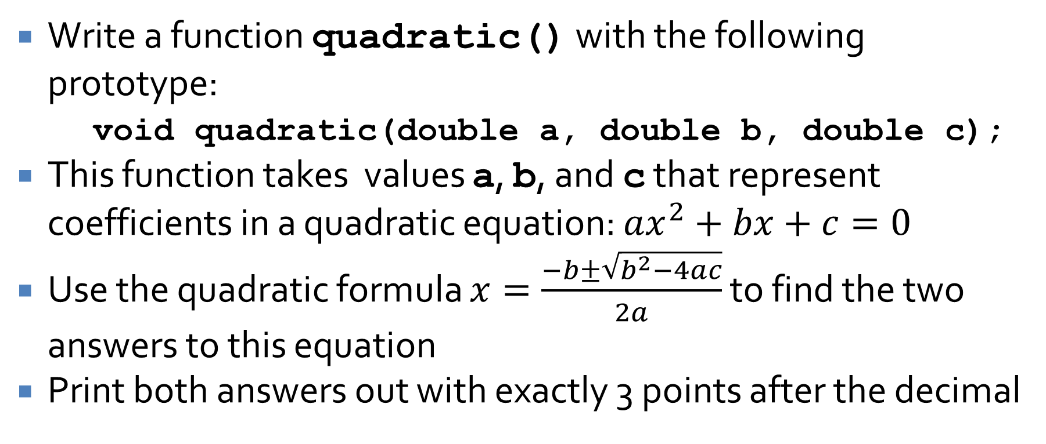
Programming practice 2
Write a function quadratic() with the following prototype:
void quadratic(double a, double b, double c);
This function takes values a, b, and c that represent coefficients in a quadratic equation: $ax^{2}+bx+c=0$
Use the quadratic formula $x=\frac{−b±\sqrt{b^{2}−4ac}}{2a}$ to find the two answers to this equation
Print both answers out with exactly 3 points after the decimal

Slide 51
Programming practice 3
Write a recursive function bits() with the following prototype:
int bits(unsigned int value);
This function takes an unsigned int named value and returns the number of 1 bits in it (0-32)
This function should behave exactly like the similar function in Project 2, except that it should be implemented recursively
Hints:
  The number of 1 bits in 0 is 0
  An even number has the same 1 bits as the rest of the number, ignoring the least significant bit
  An odd number has one more 1 bits than the rest of the number, ignoring the least significant bit

Slide 52
Upcoming

Slide 53
Next time…
Exam 1!

Slide 54
Reminders
Review all the material so far
Work on Project 3
Exam 1 on Monday

